Slide 1







American Indian Educational Resources (AIMER)
Tracey Begaye
Northern Arizona University
Mentor: Mary Lara
NASA Space Grant Statewide Symposium
Hilton Tucson East
Saturday, April 23, 2022
Notes:
Yá’át’ééh shik’éí dóó shidine’é. Shí éí Tracey Begaye yinishyé. Kiyaa'áanii nishłį́. Tódik'ǫzhi bashishchiin. Tó'aheedlíinii dashicheii. Tábąąhá dashinalí. Naʼnízhoozhí déé’ naashá.
Good afternoon, thank you all for coming. I just introduced myself in my native language. For those who do not understand, I said: ( Hello my family, friends, and people. My name is Tracey Begaye. I am Towering House Clan born for the Salt Water Clan. My maternal grandfather’s first clan is the Water Flows Together Clan. My paternal grandfather’s first clan is the Water’s Edge Clan. I am from Gallup, New Mexico. ) I am a third-year student majoring in computer engineering at Northern Arizona University. My mentor for the American Indian Educational Resources project is Mary Lara.

Slide 2


Purpose of AIMER
The American Indian Mobile Educational Resources (AIMER) project provides hands-on lessons/activities to teach STEM topics to pre-college Native American students at K-12 schools mainly on rural Indian Reservations in Arizona and New Mexico.
Notes:
Our project provides hands-on lessons/activities to teach STEM topics to pre-college Native American students at K-12 schools, mainly focusing on the schools that are Indian Reservations in Arizona and New Mexico. I cannot stress enough the importance of a program like this. We are addressing the issue of low STEM proficiency on the reservation and increasing exposure to STEM opportunities.

Slide 3

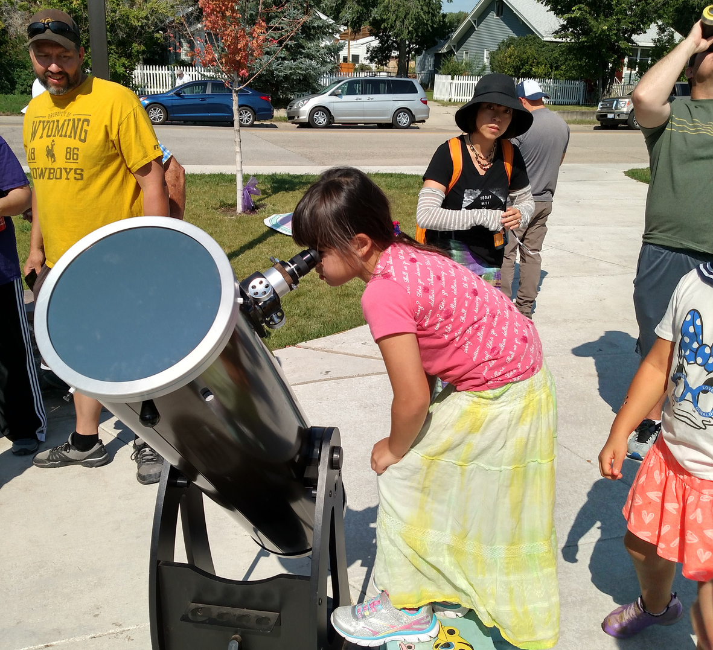
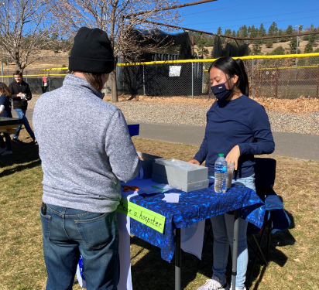

Engagement
Significant boost in attention span, conceptual understanding, and interest after the completion of our lessons.
Lessons designed specifically for each grade level.
Lessons include lunar phases, Mars helicopter Ingenuity, season causes, and more.
(T. Begaye)
Notes:
The first thing to know is that children have much shorter attention spans than adults. A child's maximum attention span is about two to three times their age, so a five-year-old child would have an attention span of, at best, fifteen minutes. With that being said, I've noticed a significant boost in attention span, better understanding of concepts, and increased interest after the completion of our lessons.
Lessons that Mary designed specifically for each grade level with an emphasis on astronomy. We incorporate these hands-on lessons/activities to make STEM more relatable and accessible for students. We have touched on lunar phases, Mars helicopter Ingenuity, season causes, and much more.

Slide 4
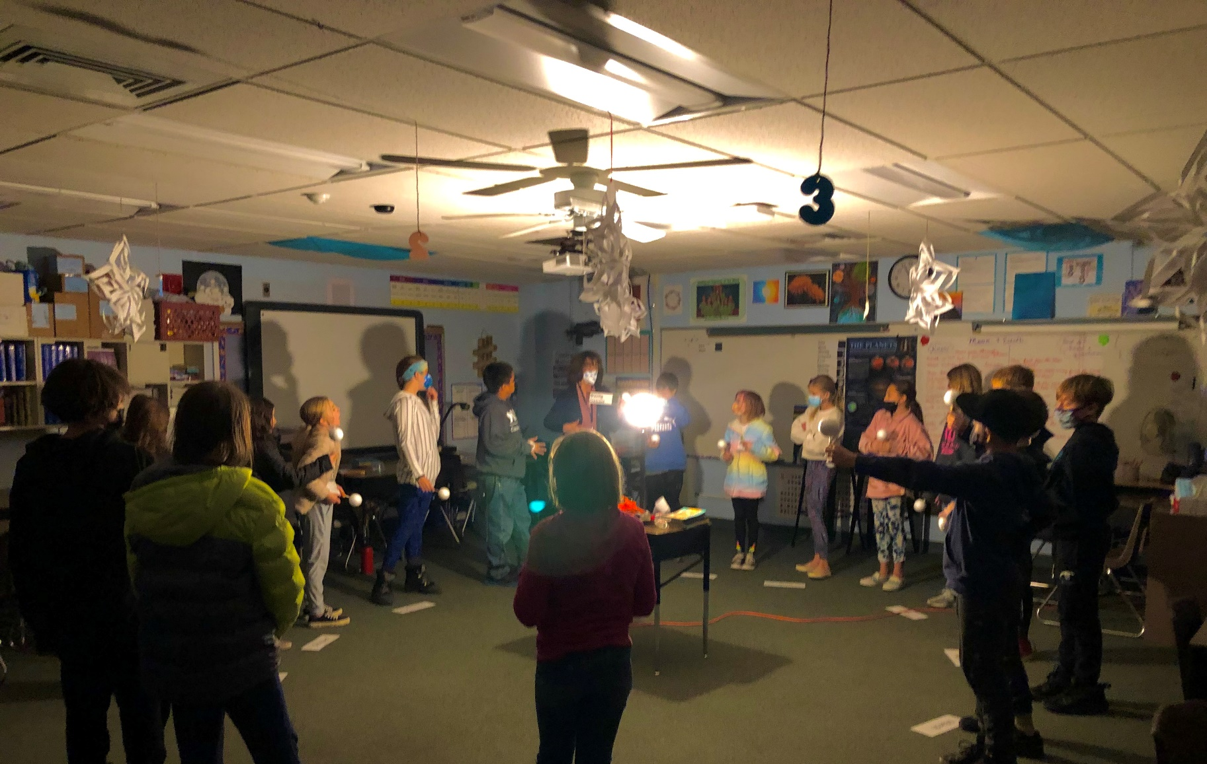
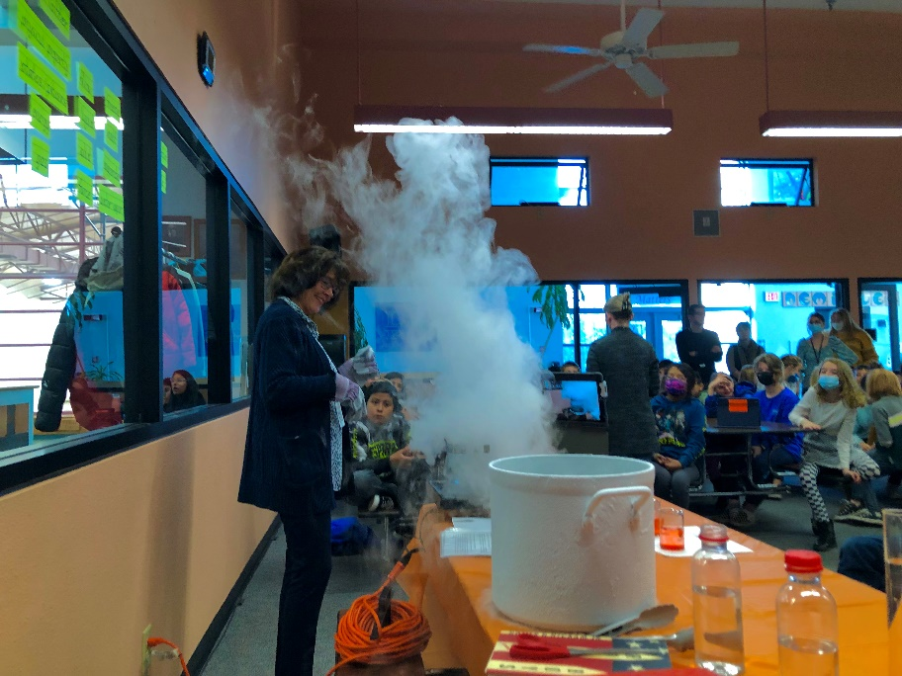
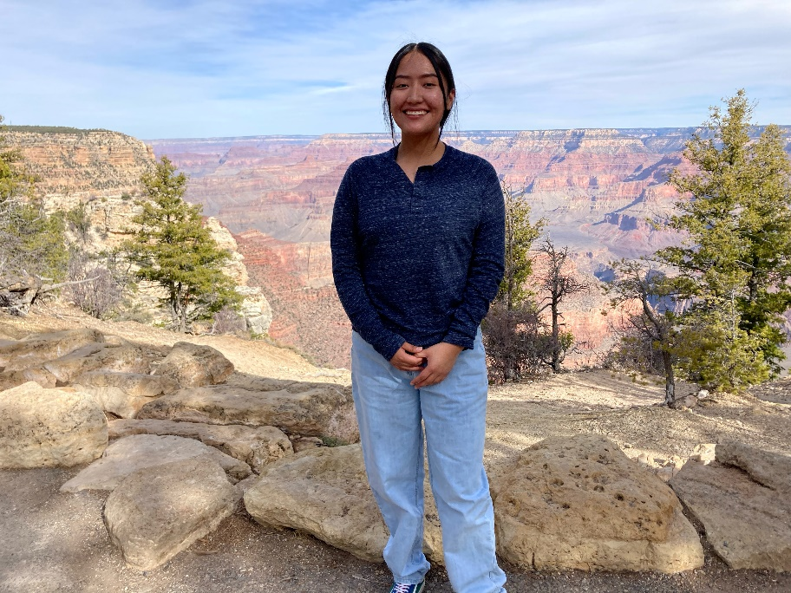
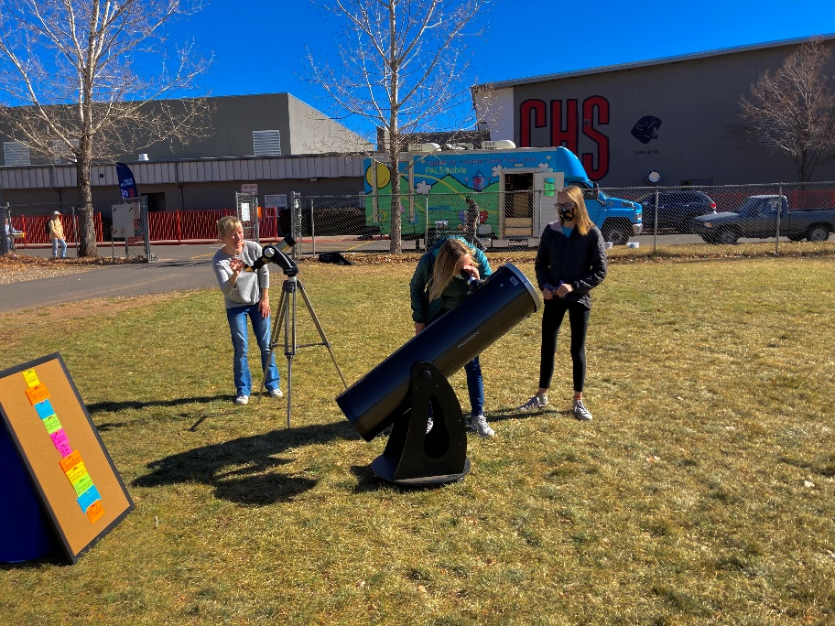
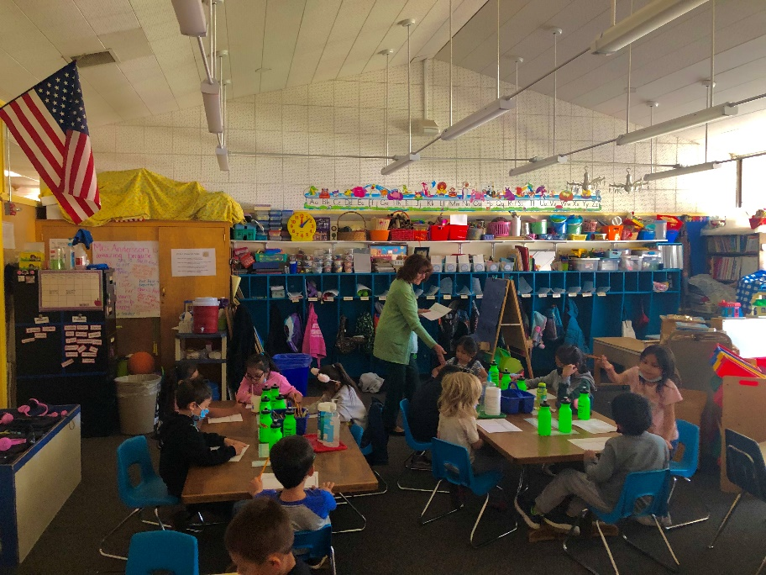
Impact
Coconino High School
DeMiguel Elementary School
Lura Kinsey Elementary School
Grand Canyon Star Party
(T. Begaye)
Notes:
When working with students, we were able to gauge those attention spans and format our presentation to incorporate that to have a positive influence. I'm going to speak now about the different schools and locations we worked with and what we've done to impact others.
Went to Coconino High School ( 1 of 3 high schools in Flagstaff, we tabled at a stem event to set up some telescopes, modeled the solar system, and collaborated with other community groups. )
Went to DeMiguel Elementary ( met with 5th graders to educate them on lunar phases using models, demonstrated the effects of liquid nitrogen( talk about balloon – “it’s great to experience and witness that as a learning science communicator” , we made ice cream for 3 classrooms using liquid nitrogen. )
Went to the Grand Canyon. ( we hosted a star party where more than 100 people attended. We set up 4 telescopes and I got to show families stars that they’ve never seen before. Thanks to the program, that was my first time visiting the grand canyon so it was a great experience.)
( One of the biggest struggles we encountered this year was limited outreach due to COVID. A lot of the schools on the reservation restricted visitors for safety concerns. )

Slide 5
Praise for AIMER
“Thank you so much Mary for the great program! The kids and adults really enjoyed learning and making models.”
“Can't wait to have you back to do a JWST program for the summer. The activity piqued the kids’ interest. The kids were asking questions and it made them think and do [the] math.”
"I love when you come in. I always learn so much myself and my students really understand lunar phases and what causes the seasons."
"Your enthusiasm and love for the subject matter really shine through and get the kids excited and interested. They always love when you come in and ask when you are coming again."
Notes:
After visiting those locations, we’ve received the following feedback from the teachers… They’ve told us that the kids and parents enjoy learning and making models. Our lessons have peaked the kids’ interests and they become more interested in STEM topics. Not only the parents & kids, but the teachers as well learn something new and understand topics better. They have also told us that their students often ask when we are coming back. Which is always great to hear.

Slide 6
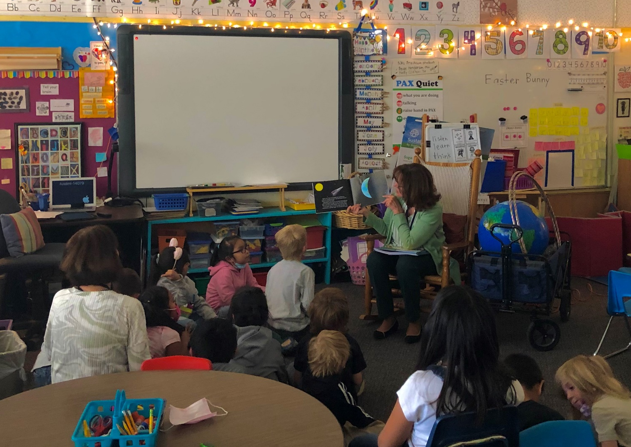


Contact Us
Requested by a teacher at any reservation school in Arizona & New Mexico
No charge to the school
First-come, first-served basis
Scan the QR code
(T. Begaye)
https://bit.ly/36pn8Um
Mary.Lara@nau.edu
Notes:
If you would like to contact us for our services, AIMER can be requested by a teacher at any reservation school in Arizona and New Mexico to supplement their classes during the academic year at no charge to the school. AIMER is scheduled on a first-come, first-served basis, using the calendar and request links located below(you can scan the QR code, and I listed our website and my mentor Mary’s email) if you are interested. These services are made available through NAU/NASA Space Grant at Northern Arizona University.

Slide 7


Acknowledgements
Mary Lara (AIMER Coordinator)
NAU/NASA Space Grant Program
Paloma Rose Davidson (Senior Academic Program Coordinator)
Department of Astronomy and Planetary Science
Notes:
I would like to take the time to acknowledge my mentor, Mary, for her mentorship throughout this research project. She provided invaluable guidance and knowledge and ensured I was set up for success in every possible way.
I would also like to acknowledge the NAU/NASA Space Grant Program and specifically Paloma Davidson for giving me this once-in-a-lifetime opportunity. Thank you for creating a positive environment within our department.
I would also like to acknowledge the Department of Astronomy and Planetary Science for providing the equipment that allows us to educate others.

Slide 8
Ahéhee' Thank You

